Slide 1
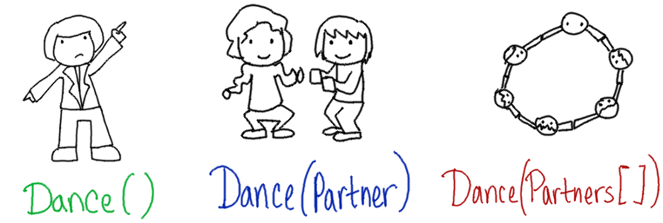
Function Overloading
& Operator Overloading
CS 201, Summer 2013

Slide 2
Function Overloading
Remember how, in Python, we could write a SumNumbers function, and it would work for integers and floats?
def SumNumbers( number1, number2 ):
return number1 + number2

Slide 3
Function Overloading
And C++ can't do that, because the parameters are defined as specific data-types -
Python
def SumNumbers( number1, number2 ):
return number1 + number2
C++
int SumNumbers( int number1, int number2 ) {
return number1 + number2
}

Slide 4
Function Overloading
C++ gets around this by using function overloading.
You can reuse a function name, so long as the function's parameter list is unique.
int SumNumbers( int number1, int number2 ) {
return number1 + number2
}
float SumNumbers( float number1, float number2 ) {
return number1 + number2
}

Slide 5
Function Overloading:
Unique Parameter Lists
A parameter list is unique if:
  There are different numbers of variables
  There are different datatypes for variables
  There is a different order of the variables
void DisplayInfo( string company );
void DisplayInfo( string name, int age );
void DisplayInfo( int age, string name );
void DisplayInfo( string name, float balance );
void DisplayInfo( Employee employee );

Slide 6
Example: OpenGL
OpenGL (A 3D graphics library) was written in C, which does not have function overloading.
(C also doesn't have classes)
C libraries are usable in C++.
A “library” is code that has been compiled to a .dll or other “lib” file. You can use the functionality in that lib.

Slide 7
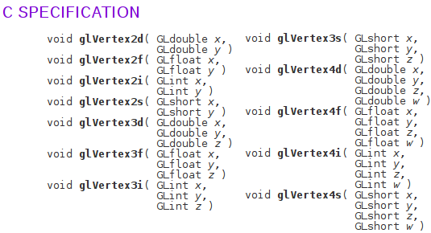
Example: OpenGL
In OpenGL, you can draw multiple vertices, which will form a polygon, a solid flat plane. However, there are multiple ways to specify these vertices:
From http://www.manpagez.com/man/3/glVertex3f/

Slide 8
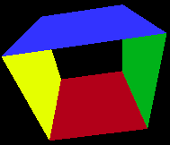
Example: OpenGL
Written this way, the user needs to remember which “glVertex” variant they want.
In C++, it could have all been under one “glVertex” name, and it would call a certain implementation of that function based on the parameters you gave it.
If it were implemented in C++:
void glVertex( float x, float y, float z );
void glVertex( float x, float y );
void glVertex( int x, int y, int z );
void glVertex( short x, short y );
Sample OpenGL program
for Code::Blocks

Slide 9
Creating an Overloaded Function...
To overload a function, you simply use the same Function Name and make sure the parameter list is unique for each implementation.
int Add( int number1, int number2 );
float Add( float money1, float money2 );
Fraction Add( Fraction fraction1, Fraction fraction2 );

Slide 10
Creating an Overloaded Function...
int Combine( int number1, int number2 ) {
return number1 + number2;
}
float Combine( float money1, float money2 ) {
float sum = money1 + money2;
sum = FormatCurrency( sum );
return sum;
}
Fraction Combine( Fraction fraction1, Fraction fraction2 ) {
Fraction common1 = fraction1;
Fraction common2 = fraction2;
common1.MultiplyNumAndDenom( fraction2.denominator );
common2.MultiplyNumAndDenom( fraction1.denominator );
Fraction sum = common1 + common2;
return sum;
}

Slide 11
ADDITIONAL READING
Function Overloading
  Chapter 4 of Pearson textbook
  http://www.learncpp.com/cpp-tutorial/76-function-overloading/

